Slide 1
KubeVela: Make shipping applications more enjoyable
KubeVela team

Slide 2
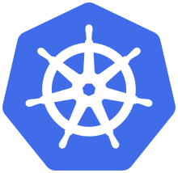

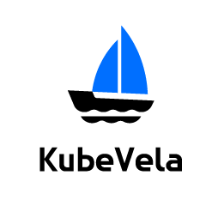

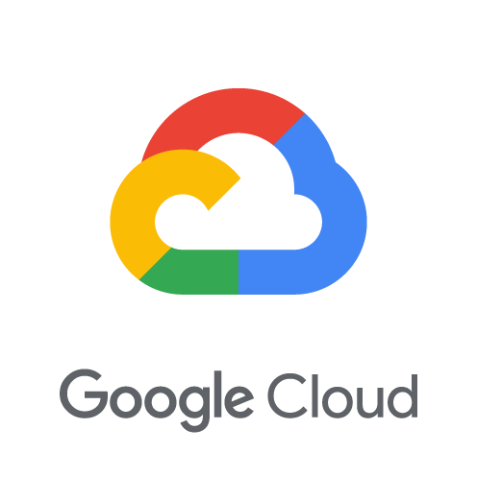
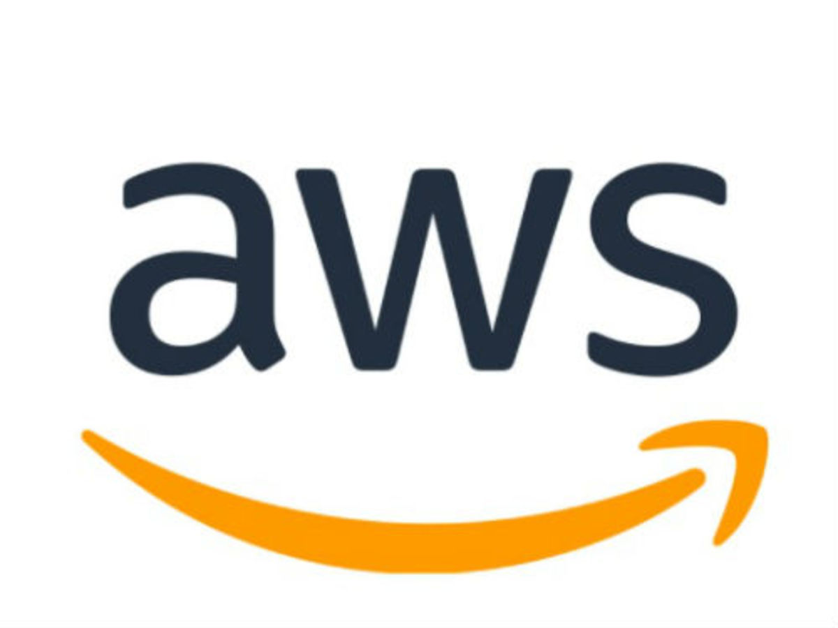

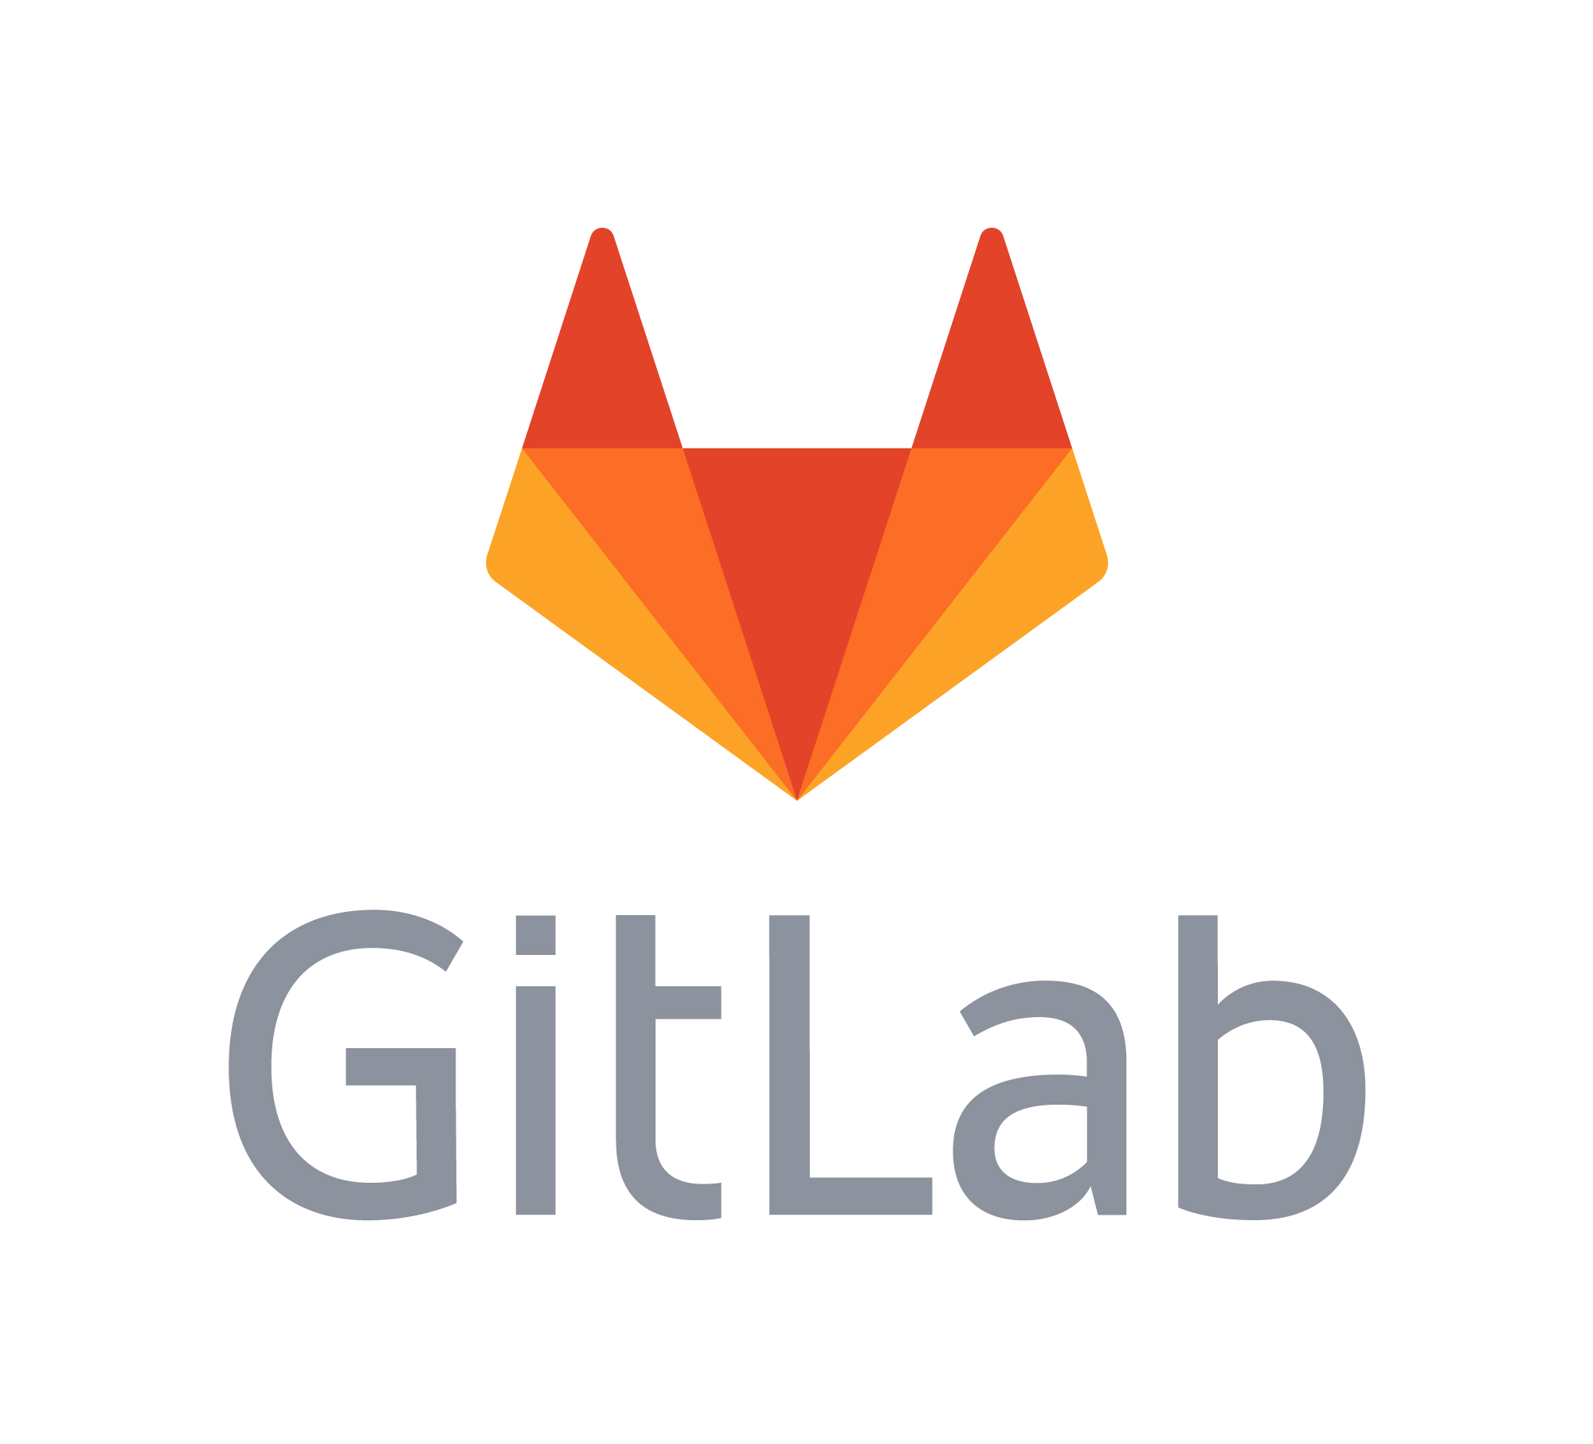



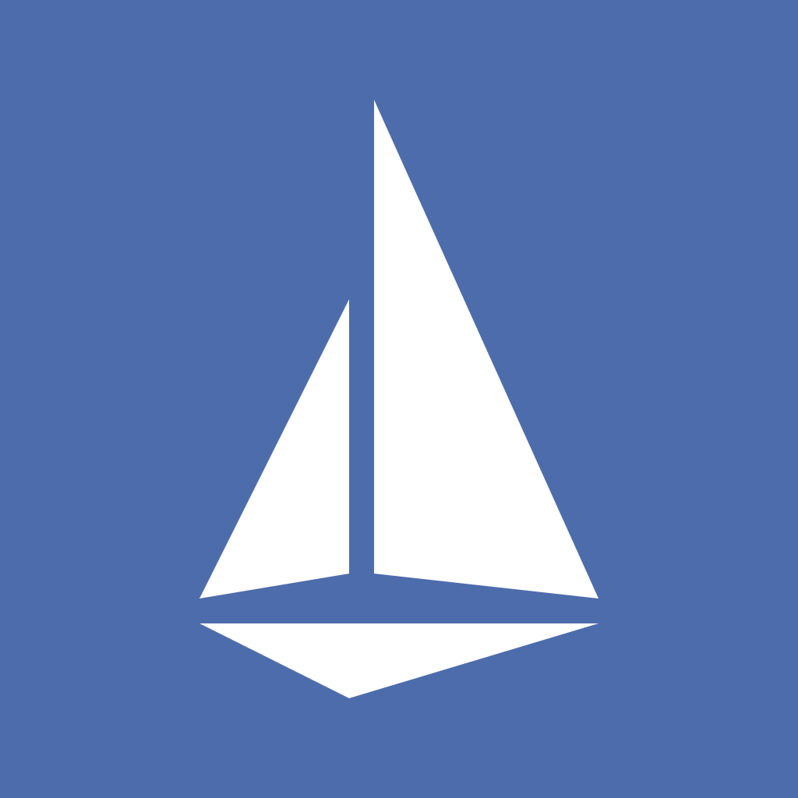

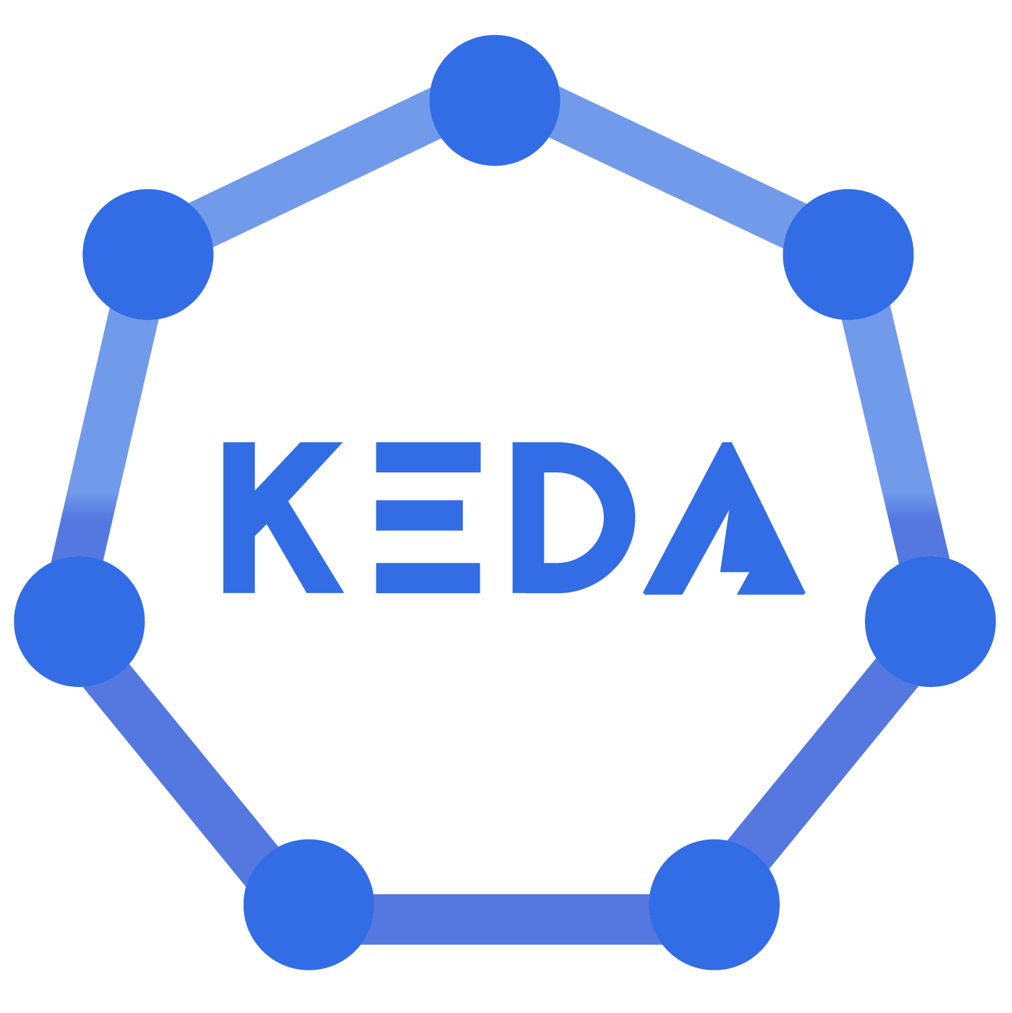
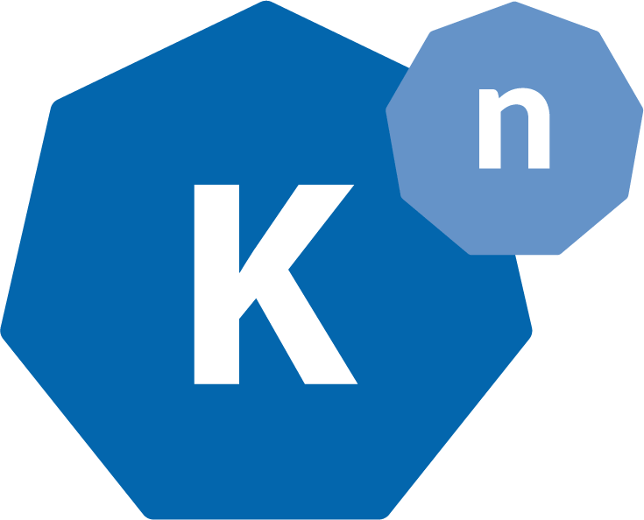
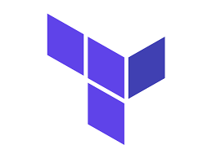
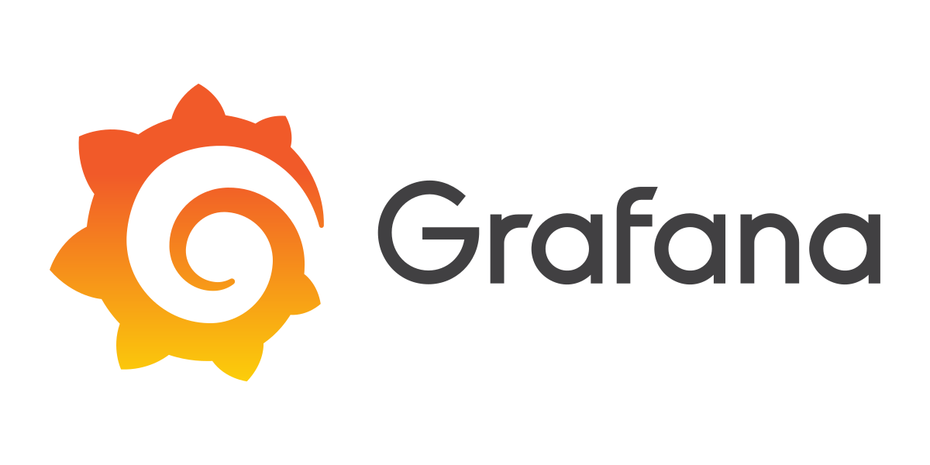

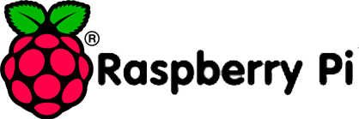
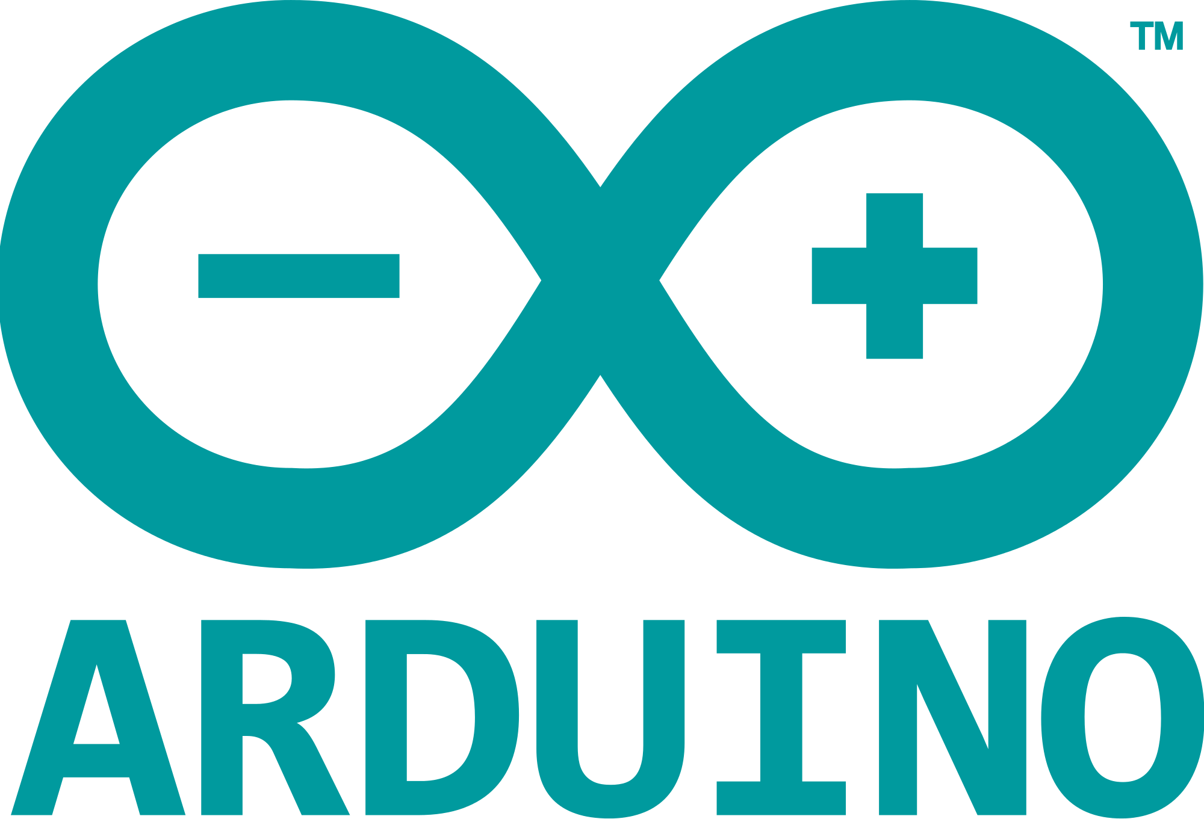
What is KubeVela
KubeVela is a modern software platform that makes delivering and operating applications across today's hybrid, multi-cloud environments easier, faster and more reliable.
Infrastructure agnostic
Programmable
Application-centric
CI Pipeline
NEW
NEW
NEW
API
CLI
UI
GitOps
Observability
Kubernetes Multi-Clusters
Jenkins
KubeVela
Render
Orchestrate
Deploy
Manage
Clouds
Addon Catalog
NEW
...
IoT/Edge
CI
CD
Day-2 Operating
Notes:
Overview

Slide 3

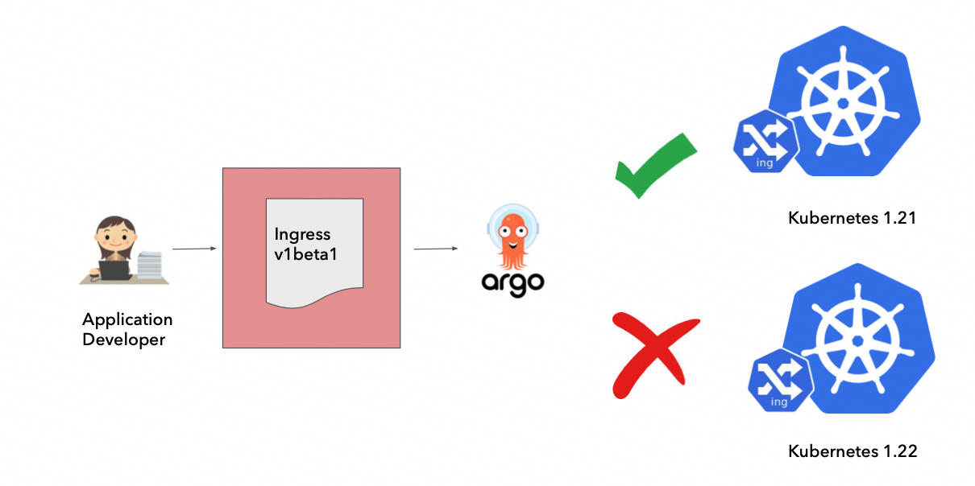
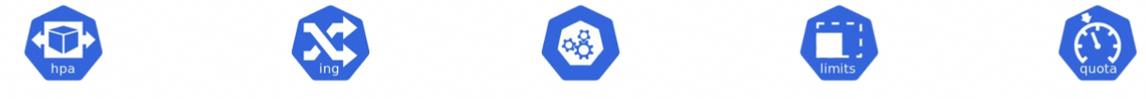
Why KubeVela?
The complexity of cloud native Infrastructure.
Application Developer
？
？
？
？
？
How to set my HPA? minReplicas, maxReplicas?
Does it enough to set my SLB health check timeout 15s?
What is PDB？ What’s maxUnavailable?
How to set CPU and memory limit?
What’s my namespace quota?
Application Developer
Kubernetes and cloud complexities are exposed directly to application developers.
Kubernetes deprecations are exposed.
Lack of operational input in the application definition.
https://thenewstack.io/how-intuits-platform-engineering-team-chose-an-app-definition/
Notes:
Day 1 App Delivery

Slide 4
Why KubeVela?
The modern application needs a hybrid/multi-cloud architecture.
Modern Application
Modern Application
RDS
ACK
SLS
ARMS
Deployment
StatefulSet
EKS
AKS
ACK
GKE
CRD Controllers
Hybrid Environment
Multi-Clusters
App Delivery not only containers but also cloud resources.
App Delivery across multi-clusters for dev/test/prod environment.
App Delivery to multi-clusters/clouds for high availability.
How to manage them in a united way?
Notes:
Day 1 App Delivery

Slide 5
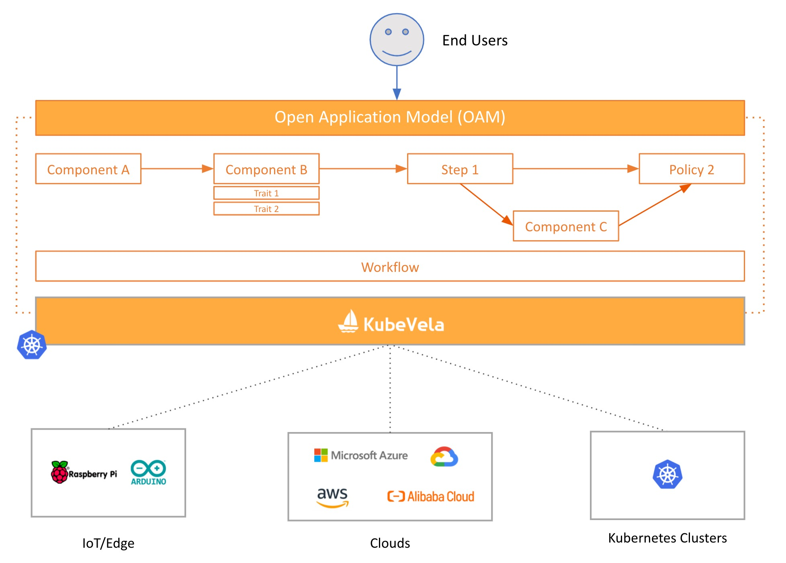
Why KubeVela?
How to do canary rollout for my app?
How to trigger a notification after my delivery succeed?
How to promote to another cluster when my app verified?
App Delivery needs a extensible workflow.

Slide 6
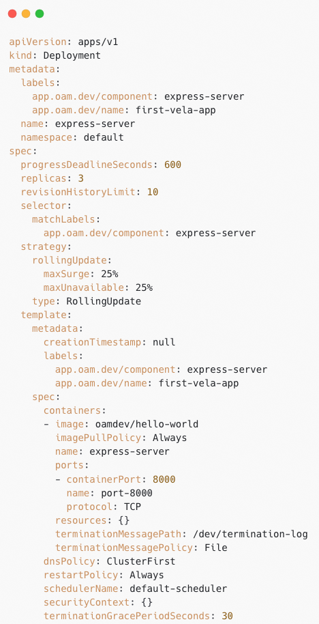
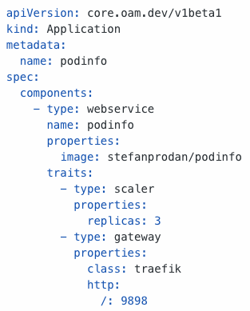
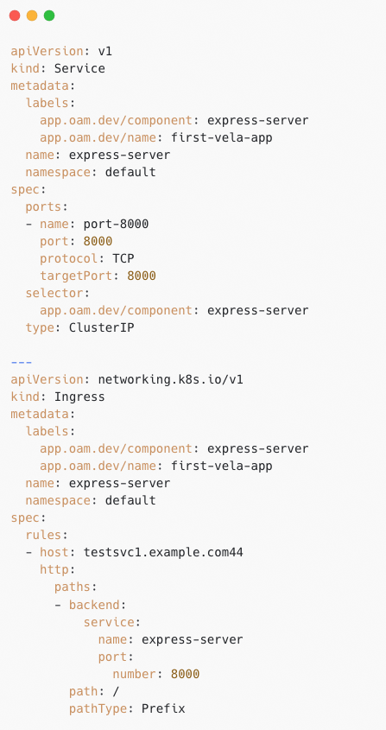
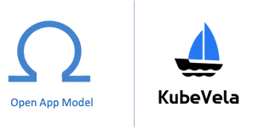
Open Application Model
VS
Consistent Application Model for Application Delivery.
Kubernetes Native Resource
The application delivery model behind KubeVela is Open Application Model(OAM).

Slide 7
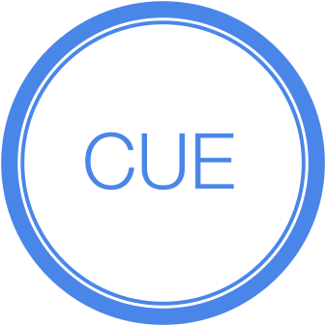
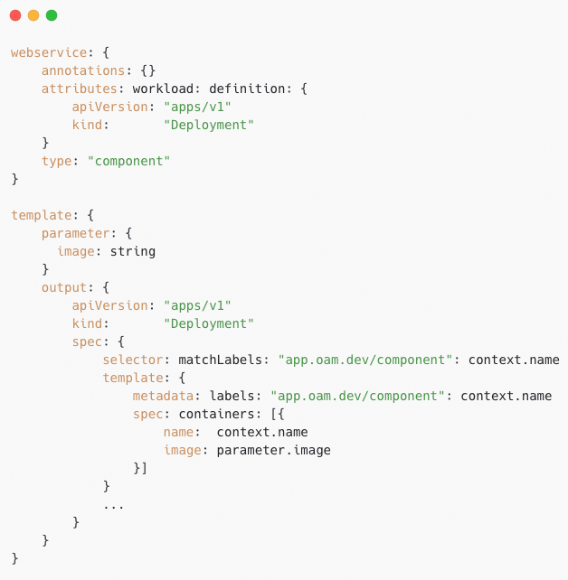
Application Model
Programmable Extensibility with CUE Configuration.
Abstraction from Best Practices.
Infrastructure Implementation agnostic.

Slide 8
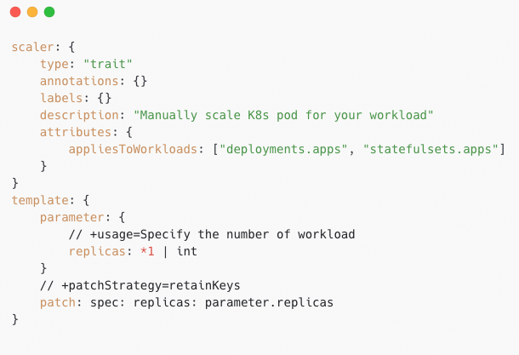
Application Model
image
replicas
WebService
Scaler
Gateway
X-Definition
Component
Trait
Trait
Output
Patch
Outputs
Deployment
Service
Ingress
Separation of Concerns

Slide 9
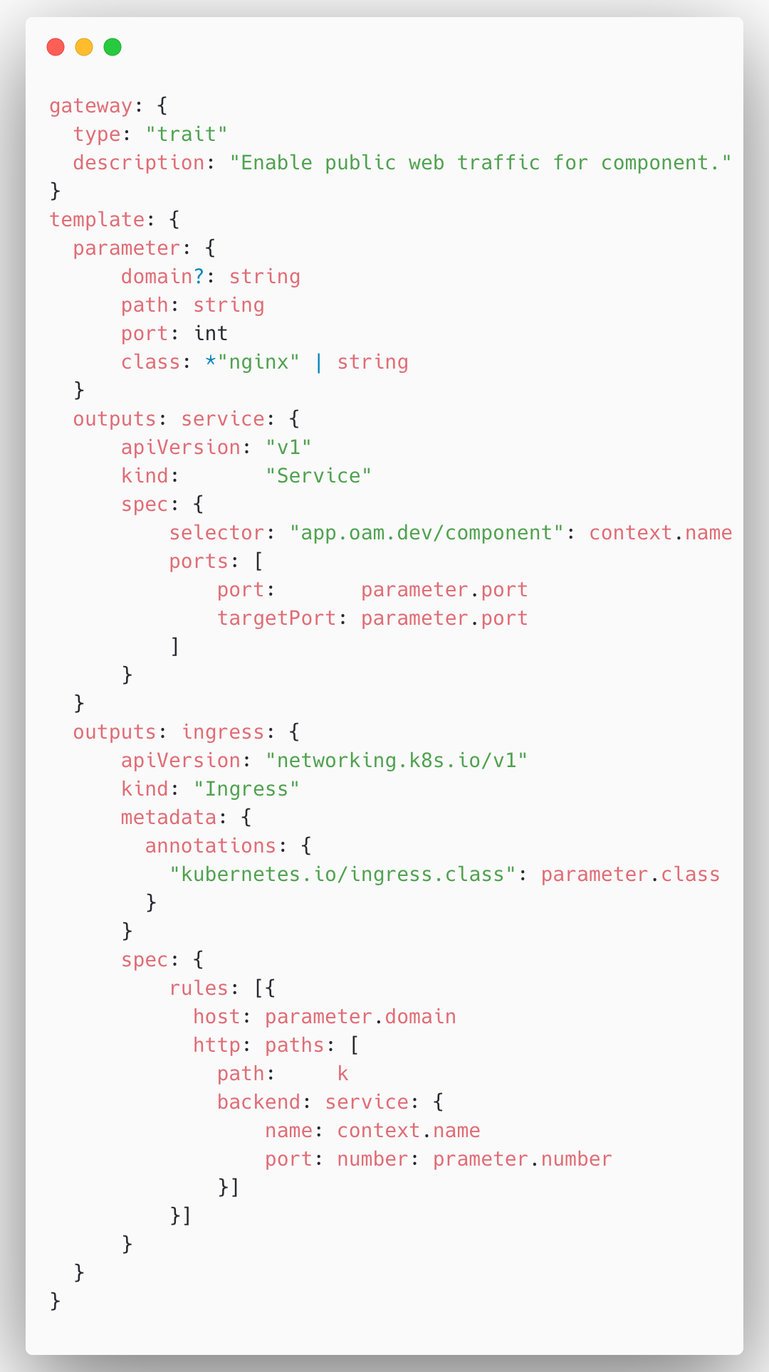
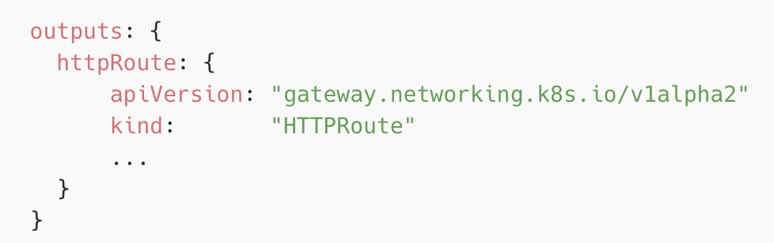
Application Model
path
port
class
domain
Gateway
TraitDefinition
Deployment
StatefulSet
Service
Ingress
CloneSet
Applies to different workloads.

Slide 10
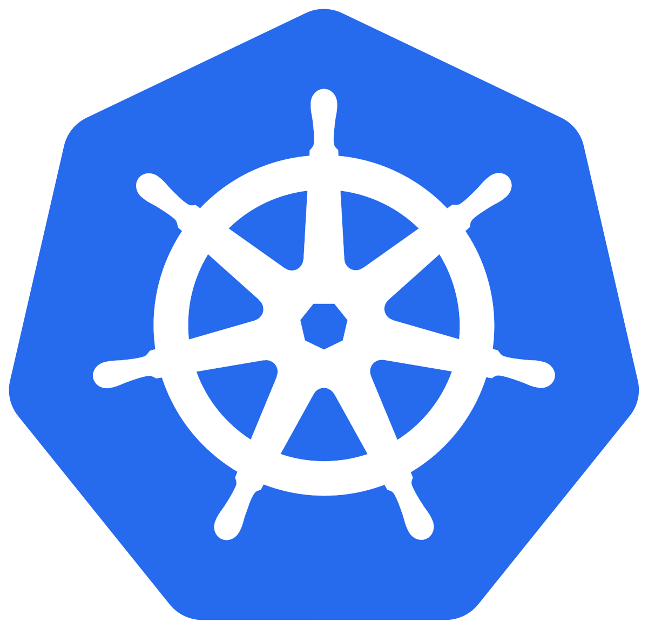

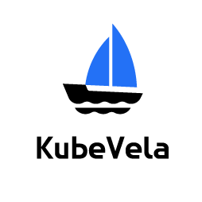

The basic user workflow of KubeVela Platform
Flexible, Extensible and Programmable.
Component Types
Traits
Web Service
Autoscale
Cron Job
Rollout
Database
Route
Capability Templates: X-Definition
register
Platform Team
OAM
X-Definition
Deployment
Staging Cluster
Production Cluster
Initialize Environments: Addons
OAM
X-Definition
OpenKruise
Enforce best practices and deployment confidence
Istio
KEDA
Application
Flagger
Web Service
Route
Production Cluster
Database
deploy
Terraform Controller
OAM
Application
End Users
Choose target Environment
Choose capability Templates, fill in values, assemble them into an app
e.g.
image=app
replicas=2
host=myapp.io
Enjoy PaaS-like experience
Clouds
RDS
SLB
ECS

Slide 11
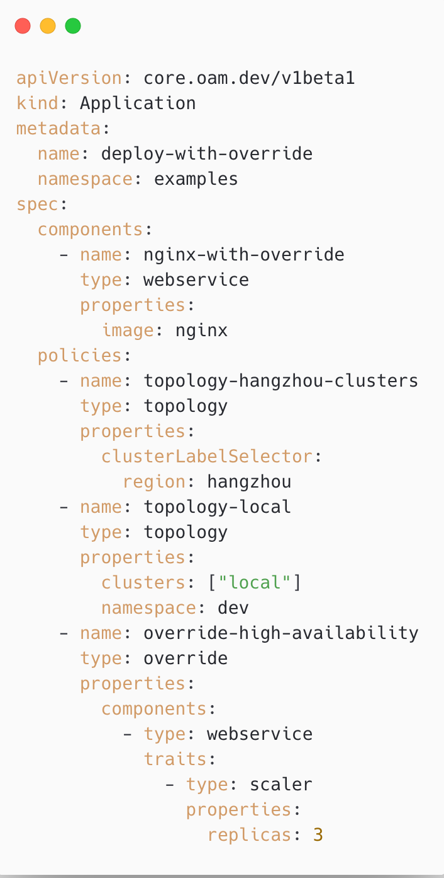
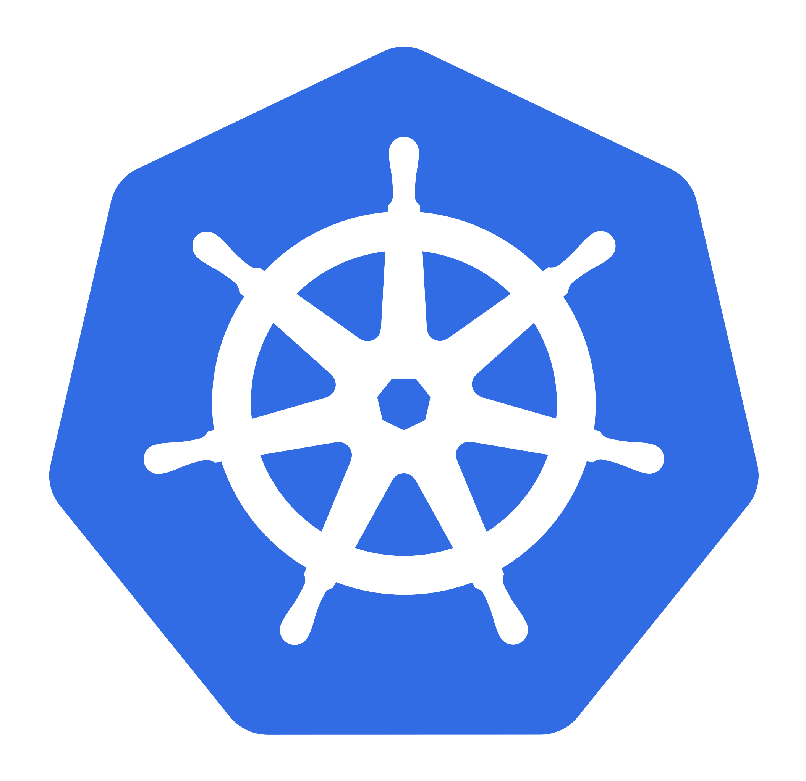
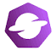

Multi-clusters/hybrid-environments as first-class citizen
KubeVela Control Plane
Cluster Gateway
Push
Push
Pull
Pull
No additional control plane overhead
Open Cluster Management
Managed Kubernetes
On-premises
On-premises
IoT/Edge
Natively supports multi-clusters with rich placement strategy.
Support both Push and Pull model for cluster management.
Runtime agnostic, adopts any plugins and manage them only in the control plane.

Slide 12


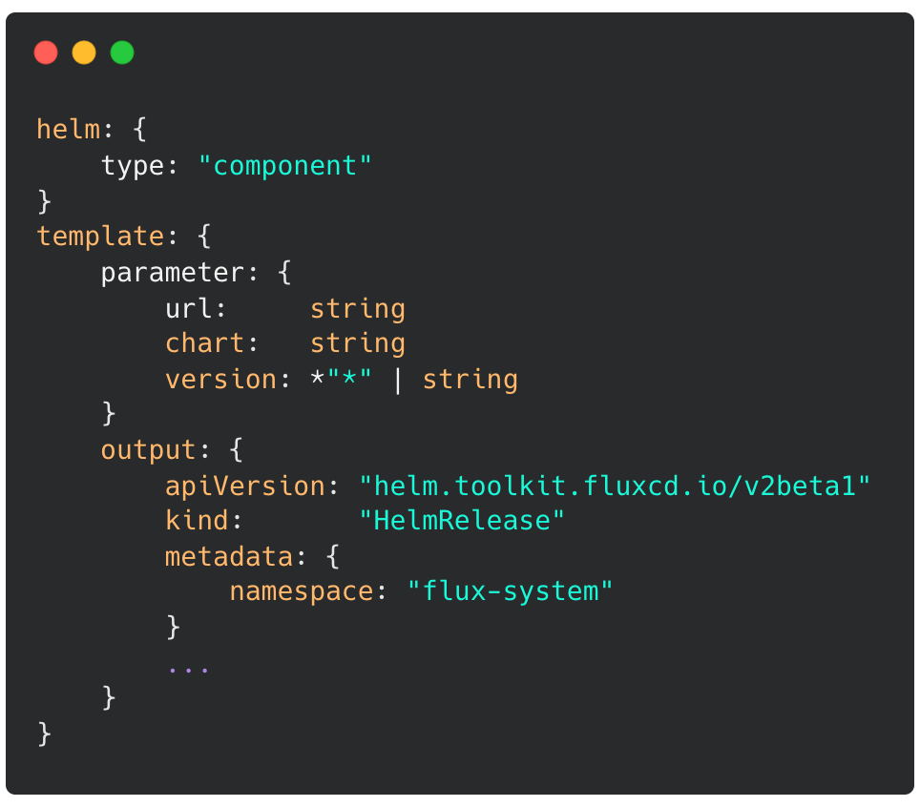

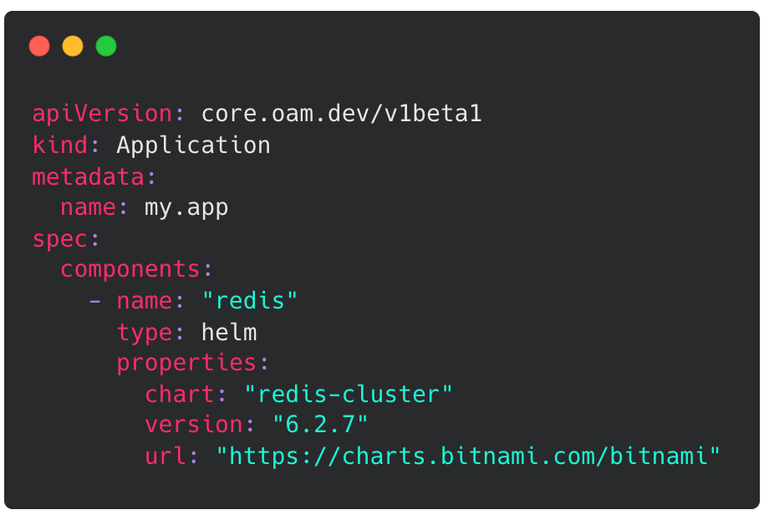

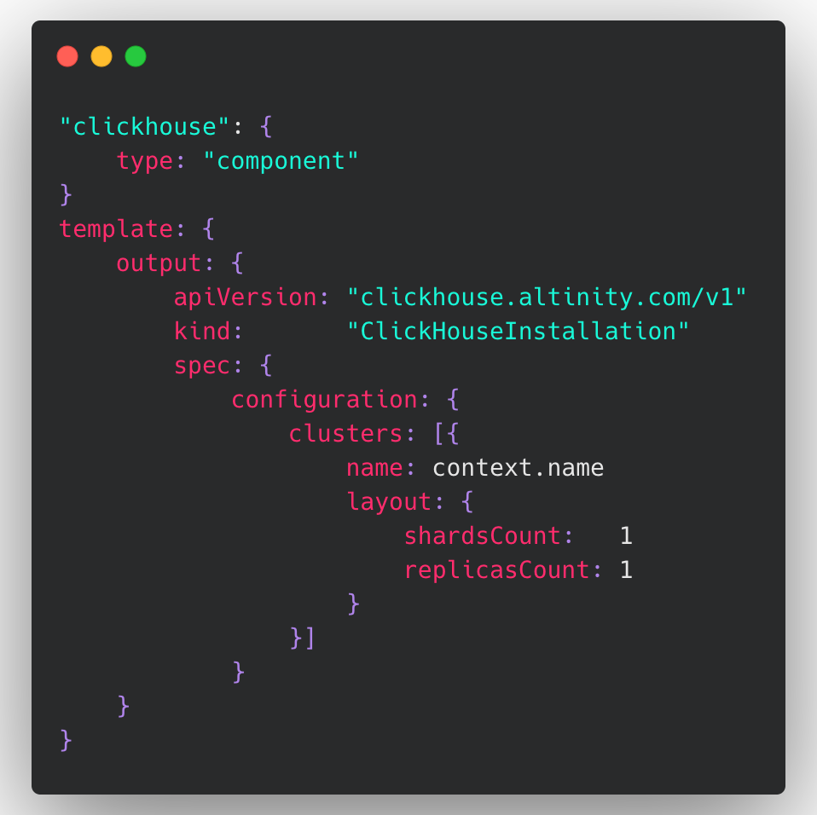


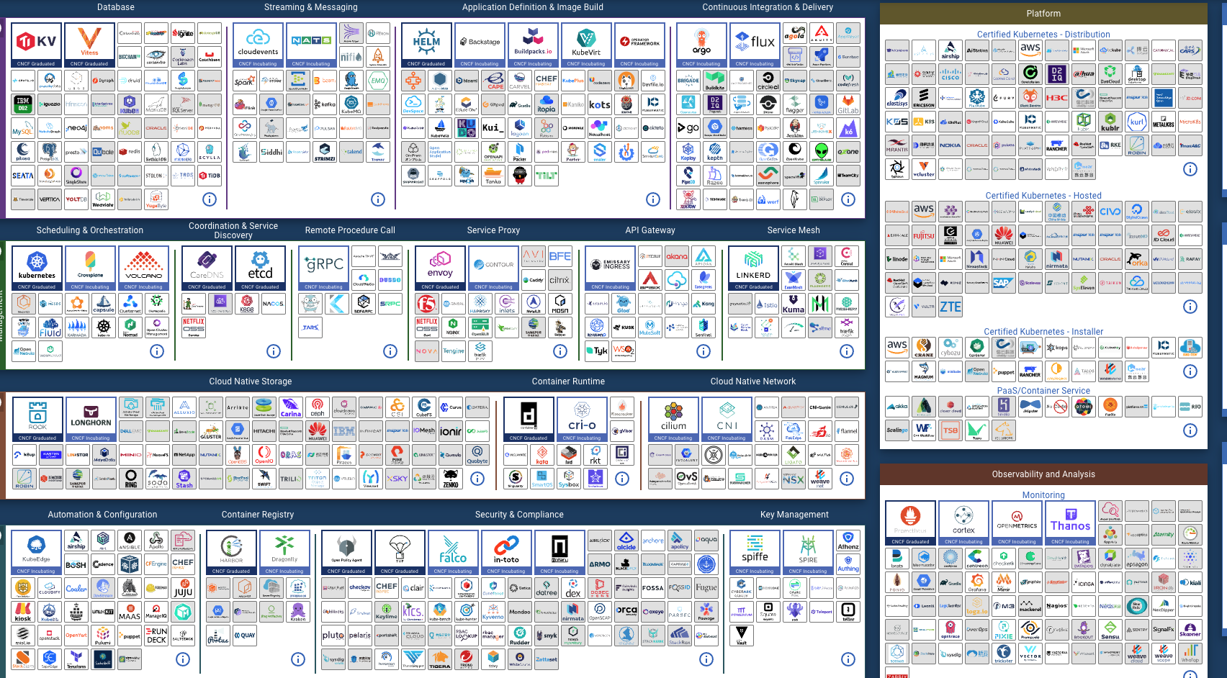
Use addon to build your own extension!
Platform Builder
OAM Definitions
Capability Providers
End User
OAM Application
FluxCD
webservice
Redis
Task
helm
Clickhouse
RDS
Clickhouse Operator
reference the definition
Register as Definition Modules
Addons are Discoverable, Reusable and easy-to-install capability bundles.
The community currently have 50+ addons already.
Addon Catalog
https://github.com/kubevela/catalog

Slide 13
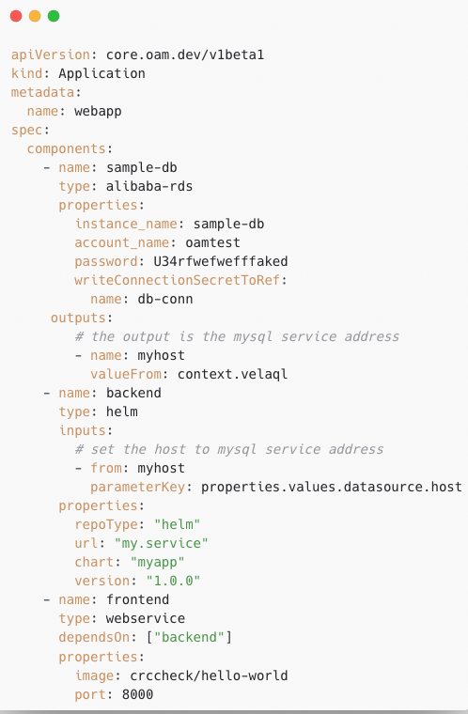


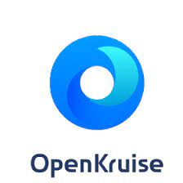
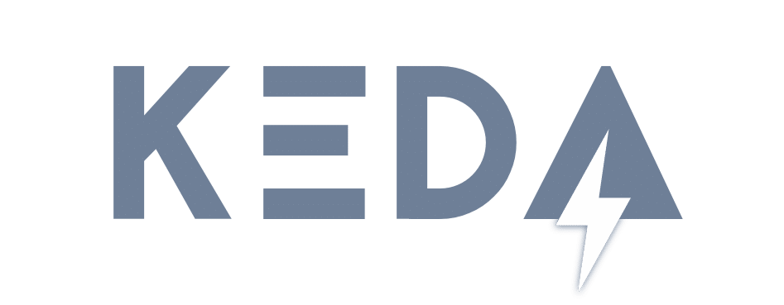



A unified application delivery
Control Plane
Application
Component A
Data Input/Output
Component B
Dependency
Component C
traits
traits
traits
Terraform controller
Community addons
Runtime Level Capabilities
Clouds
Kubernetes Clusters
KubeVela Community Addons

Slide 14
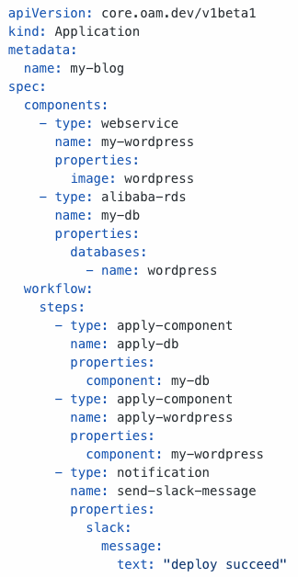
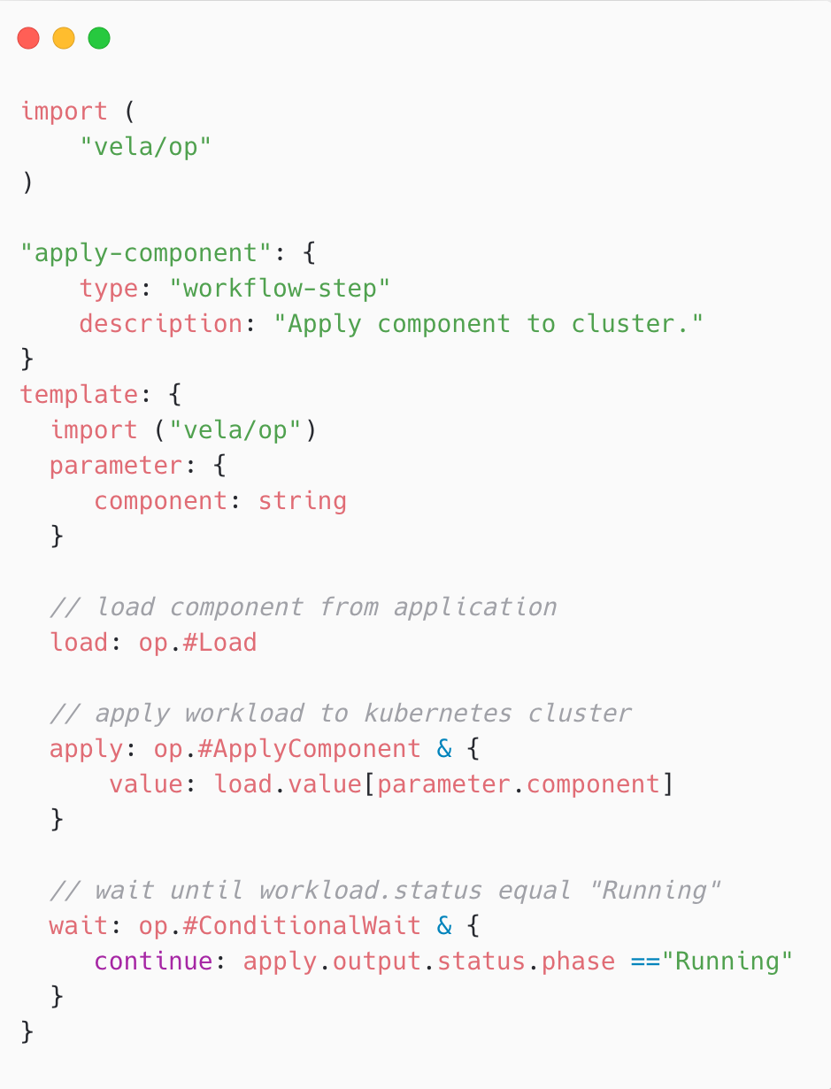




KubeVela Workflow: orchestrate and glue ANY delivery actions
Rich Capabilities &
Process Control
Schema Checksum
& Secure Execution
Fast &
Lightweight
Extensible,
Programmable,
Reusable

Slide 15



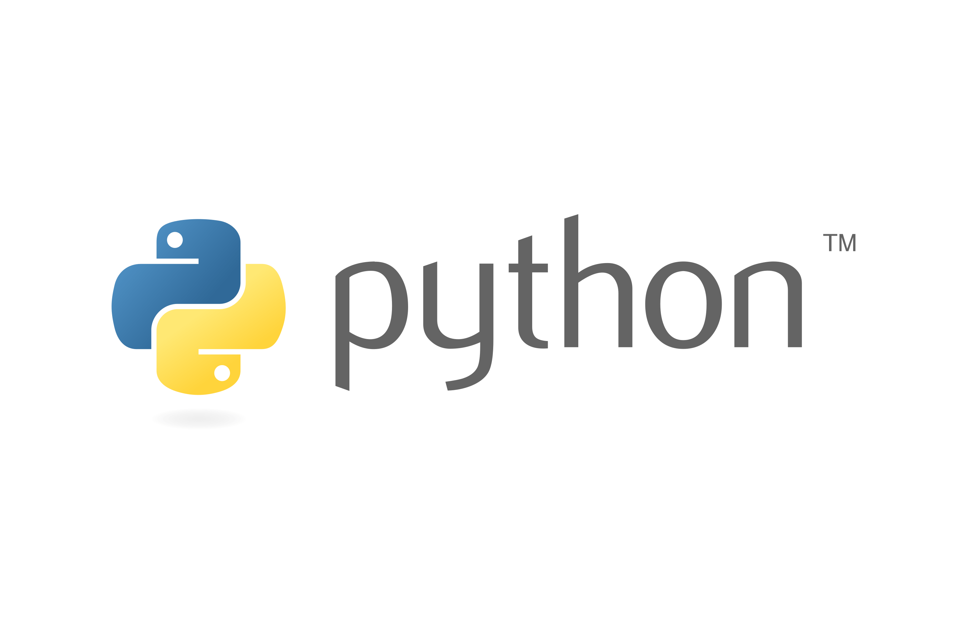
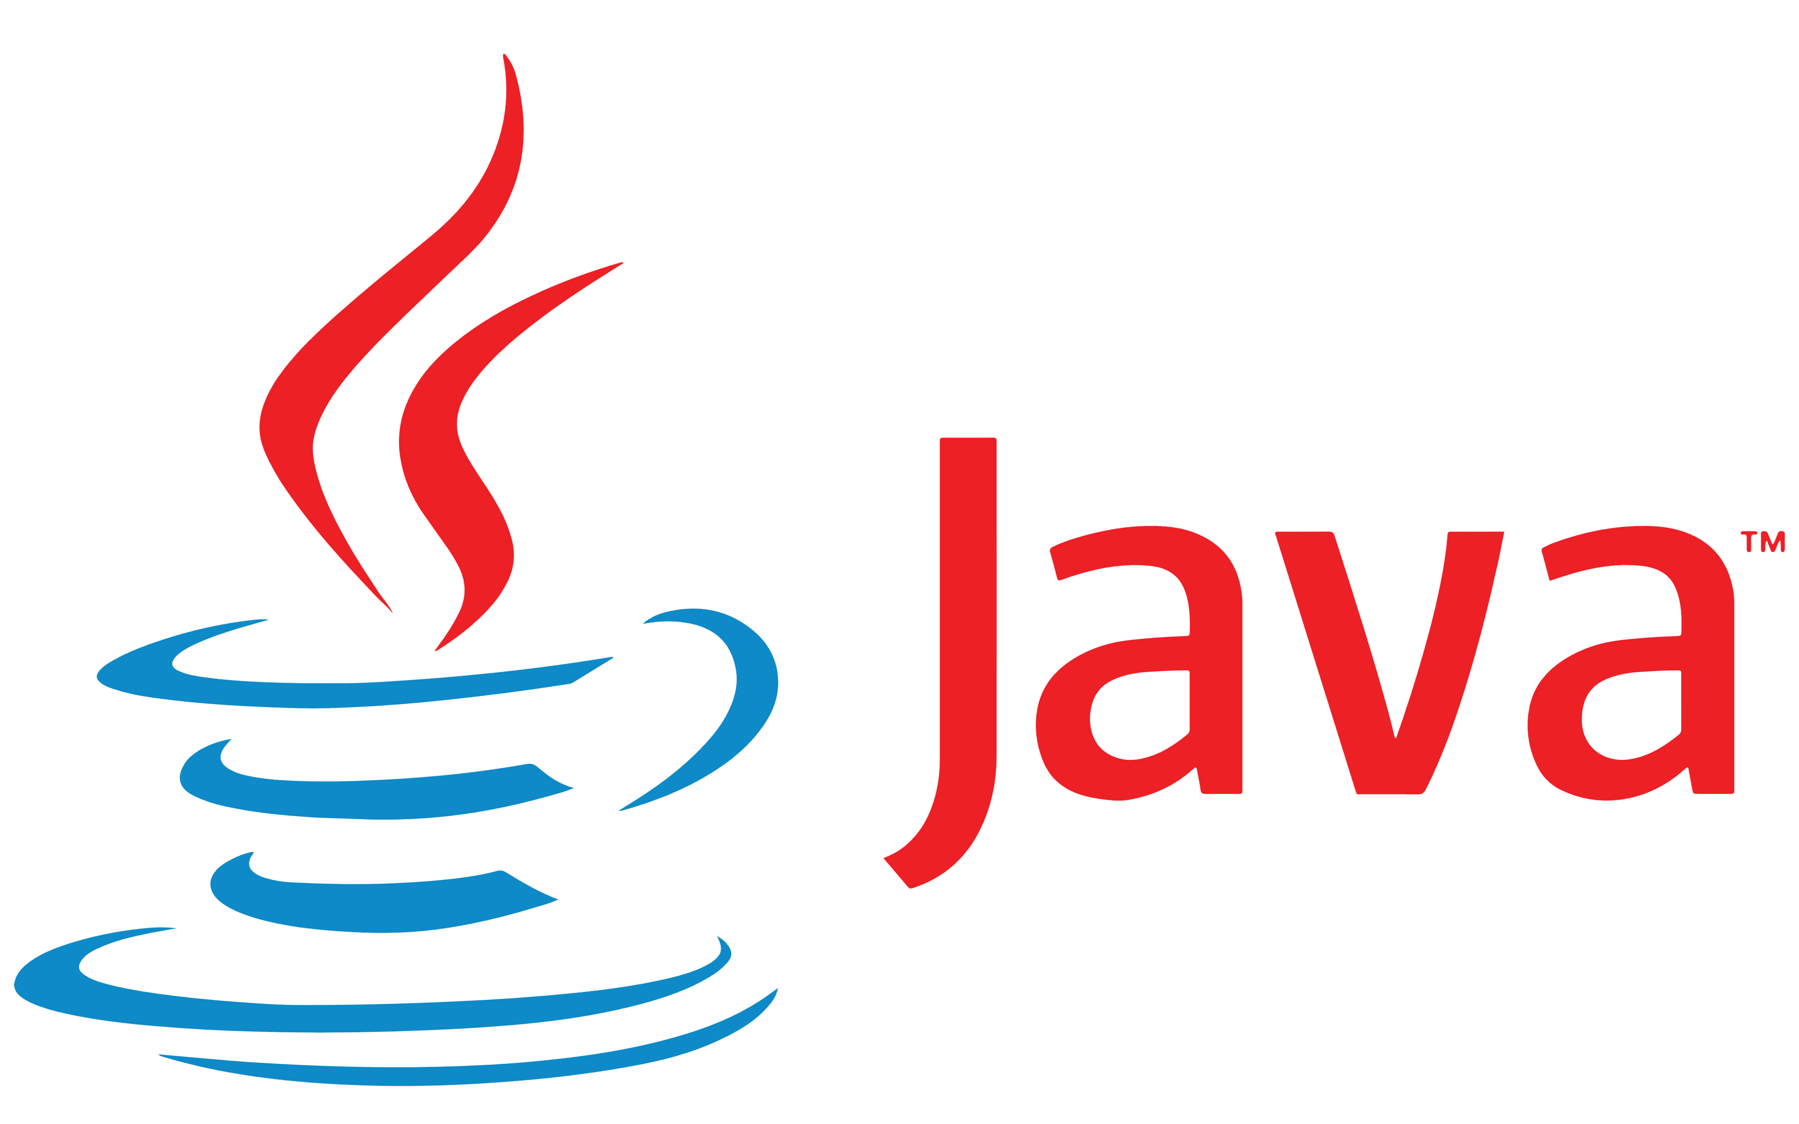




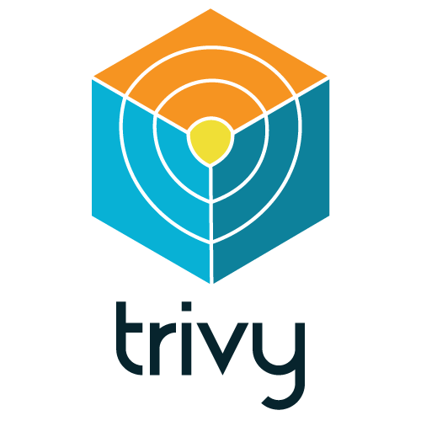

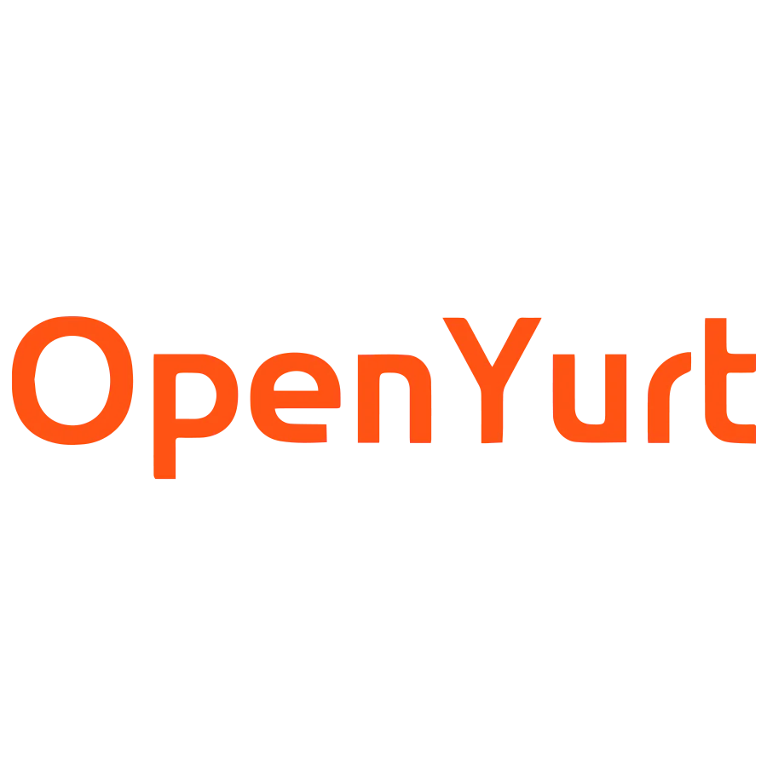






The Application Delivery behind KubeVela a consistent, programmable, declarative workflow!
Application Workflow
Data Passing
Image ID
Step-Group
Step G
Deploy To Prod A
Output
Input
If: Always
Timeout: 24h
Approved
Step A
Build Image
Step B
Push Image
Step C
Image Scan
Step E
Deploy To Dev
Step F
Suspend
Step H
Deploy To Prod B
Step J
Notification
If: C.failed
Declined
Or
Timeout
Step I
Deploy To Prod C
Step D
Image Cleanup
Workflow Step Definition （IaC Abstract）
Built-in Functions
Install Built-in/Custom Functions
Your Custom Functions
HTTP Requests, Multi-Cluster Deploy, Process Control, etc…
…
Integrate With CI
Multi-Env Deploy
Scan Addon
Open Cluster
Management
IOT / Edge
HTTP Request
Cloud Providers
Multi-Clusters
Notes:
Overview

Slide 16
Example: addons for GitOps solution
Use fluxcd to sync YAML Artifacts from Repo to clusters.
Use VelaUX to integrate with legacy push mode from CI systems.
Use OCM to manage clusters in PULL mode.
Use Terraform controller to manage cloud resources.
Use OpenYurt for Iot/Edge connection and management.
CI Pipeline
Jenkins
https://kubevela.io/blog/2021/10/10/kubevela-gitops
CI
Src Code Repo
Artifact Registry
Download Artifacts
Push app.yaml
(legacy mode)
Subscription
Auto or manually configure
FluxCD
VelaUX
Runtime K8s Cluster A
OCM
Sync
KubeVela
Terraform controller
Cloud Services
Config Repo
CD
FluxCD
OpenYurt
Application YAML
Control Plane K8s
KubeVela Addons
IoT/Edge

Slide 17
Why KubeVela?
KubeVela provides a unified Day-2 application management capability for all it’s extensibility.
Notes:
这里可以统一归类到 day-2 management

Slide 18
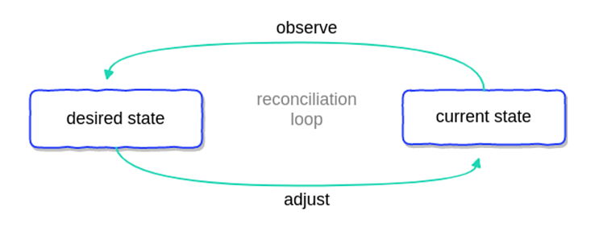
Resource Management
No configuration drift.
KubeVela
Application
Deployment
image: desired
The KubeVela Application repeatedly checks if managed resources are always in accord with the spec declared during the delivery process. It can effectively prevent configuration drift.
Deployment image edited by anonymous.
KubeVela
Application
Deployment
image: mallicious
Application recovers the deployment to desired.
KubeVela
Application
Deployment
image: desired

Slide 19
Resource Management
Automated garbage collection.
Resources sharing across applications.
v1
KubeVela
Application
Deployment X
Primer
Application
Application
Deployment
Application Upgraded.
Application
Sharer
v2
Outdated
Deployment X
Primer application deleted.
KubeVela
Application
Application
Primer
Deployment
Deployment Y
Application
Sharer
Application recycles outdated resources.
v2
Deleted
Deployment X
Last application deleted.
KubeVela
Application
Deleted Application
Primer
Deployment
Deployment Y
Recycle
The KubeVela Application recycles resources when the application itself is updated or deleted. Users can configure various strategy for outdated resources, such as keeping them or removing them.
Resources can be shared by multiple applications. Shared resources are editable by the primer application and readable by all sharers. The last exit application is responsible for recycling them.

Slide 20
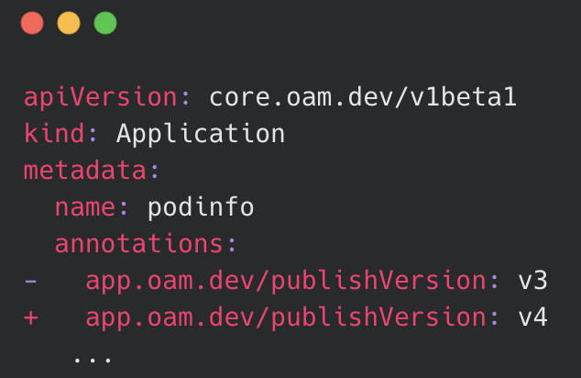
Application Version Control
History version recorded.
Rollback to succeeded version.
Inspect changes across versions.
v4
v1
v3
v1
v5
v1
Application
Status: runningWorkflow
ApplicationRevision
ID: zebra Date: Oct 18th
Hash: b88bc2fe Size: 631KiB
Application
Status: running
ApplicationRevision
ID: zebra Date: Oct 18th
Hash: b88bc2fe Size: 631KiB
Application
Status: runningWorkflow
ApplicationRevision
ID: zebra Date: Oct 18th
Hash: b88bc2fe Size: 631KiB
v2
v2
ApplicationRevision
ID: tiger Date: Oct 20th
Hash: eea9ad2c Size: 621KiB
ApplicationRevision
ID: tiger Date: Oct 20th
Hash: eea9ad2c Size: 621KiB
v2
ApplicationRevision
ID: tiger Date: Oct 20th
Hash: eea9ad2c Size: 621KiB
v3
v3
ApplicationRevision
ID: dolphin Date: Oct 20th
Hash: 1c7640bc Size: 625KiB
rollback
ApplicationRevision
ID: dolphin Date: Oct 20th
Hash: 1c7640bc Size: 625KiB
v3
ApplicationRevision
ID: dolphin Date: Oct 20th
Hash: 1c7640bc Size: 625KiB
v4
v4
ApplicationRevision
ID: giraffe Date: Oct 22th
Hash: 3f7409ca Size: 628KiB
ApplicationRevision
ID: giraffe Date: Oct 22th
Hash: 3f7409ca Size: 628KiB
v4
ApplicationRevision
ID: giraffe Date: Oct 22th
Hash: 3f7409ca Size: 628KiB
$ vela live-diff my-app
- type: webservice
name: webapp
properties:
- image: webapp:dolphin
+ image: webapp:panda
v5
publish
ApplicationRevision
ID: panda Date: Oct 24th
Hash: 8e62d36f Size: 629KiB
While KubeVela application usually automatically publishes new versions on spec changes, it is also possible to manually control the version publish, which allows users to edit application first and commit changes later.
Each KubeVela Application keeps limited history versions. Each version is a snapshot for the past delivery. Both the application and related definitions are recorded.
The KubeVela Application supports rolling back to history succeeded versions when new publish failed. Inspecting differences across versions is available as well.

Slide 21
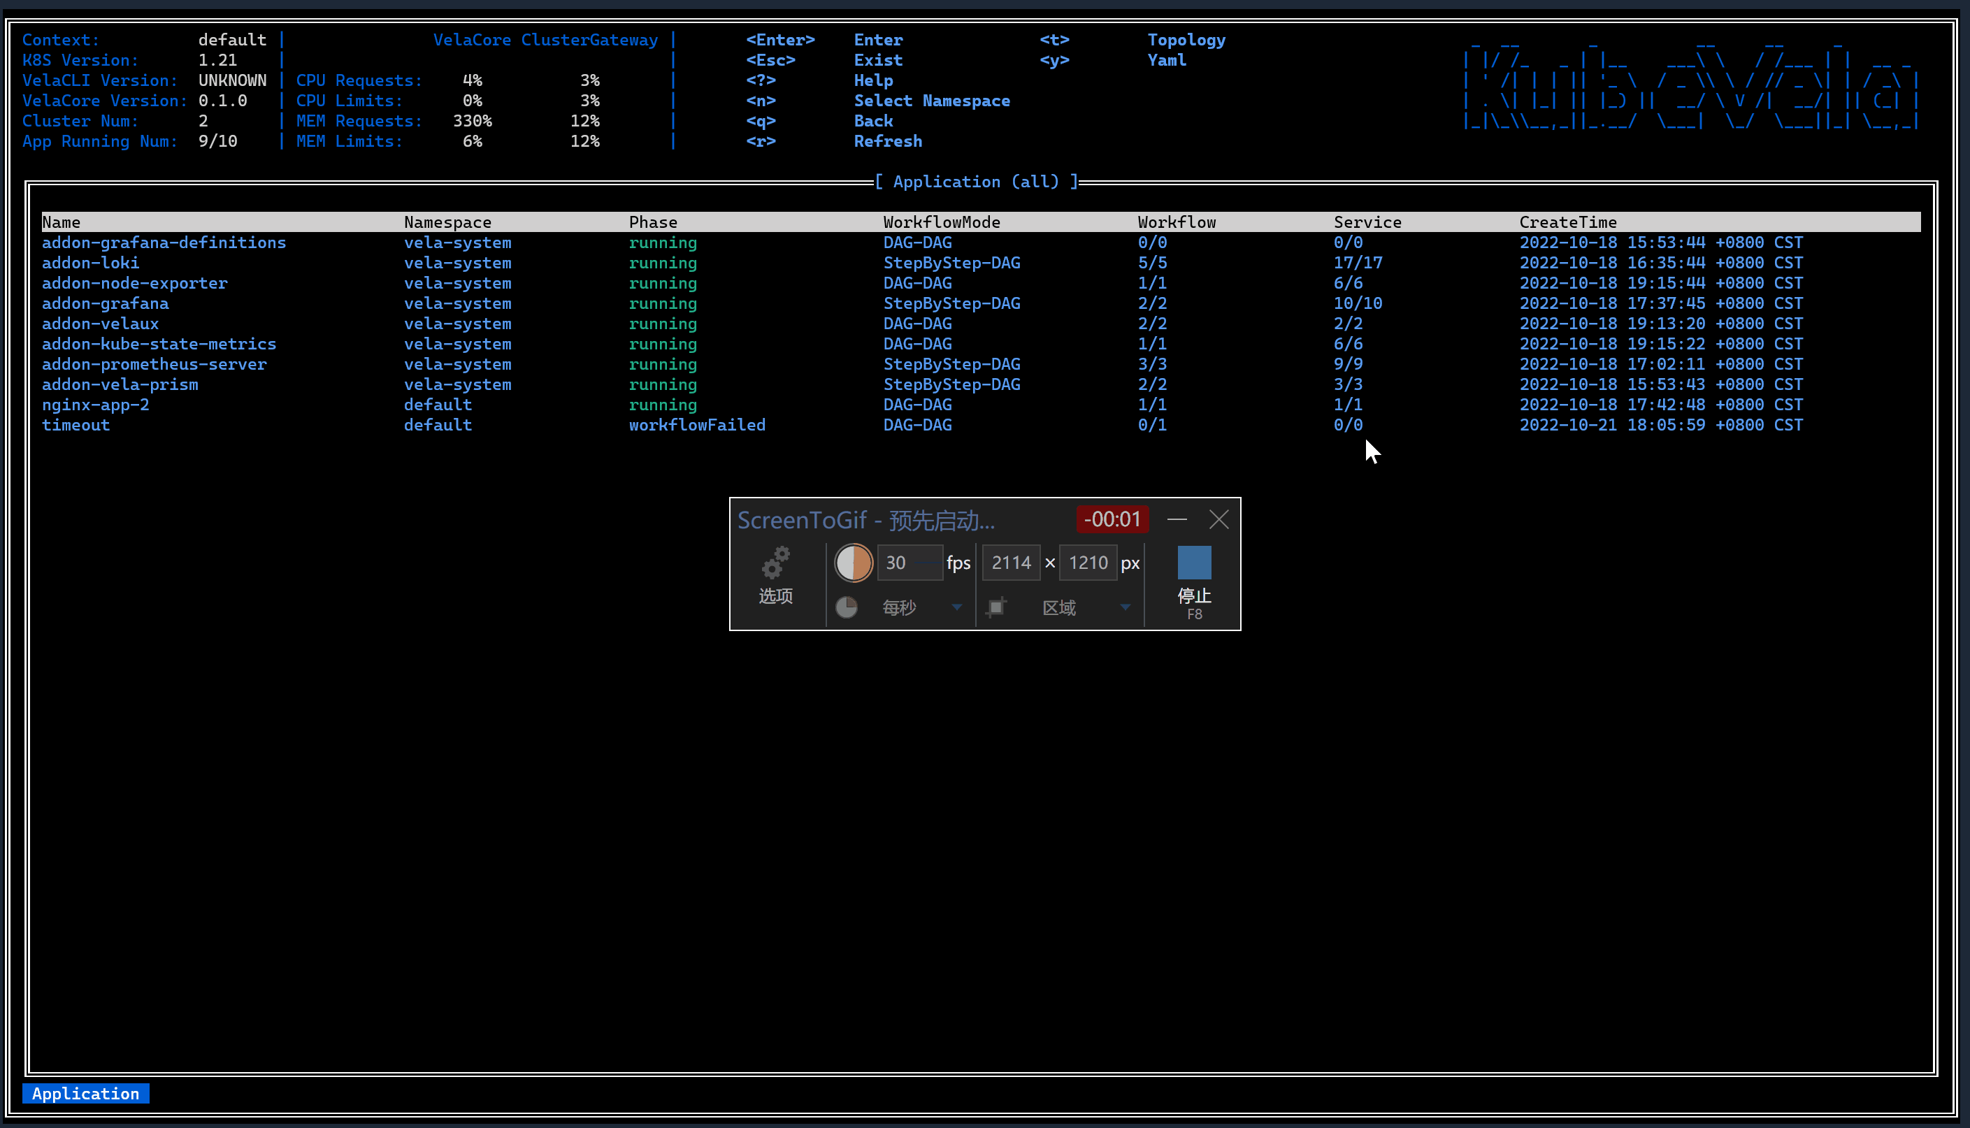

Observability as first class citizen
vela status
vela top
vela debug
Resource Topology
History Logs
vela exec
vela logs
vela port-forward
Cloud Shell
Workflow Progress
Vela CLI
VelaUX
KubeVela Application
observability traits
Dashboard
Metrics
Logs
Grafana
Prometheus
Loki
Observability works for all extended resources across multi-clusters.
Operating multi-cluster resources in a consistent way.

Slide 22
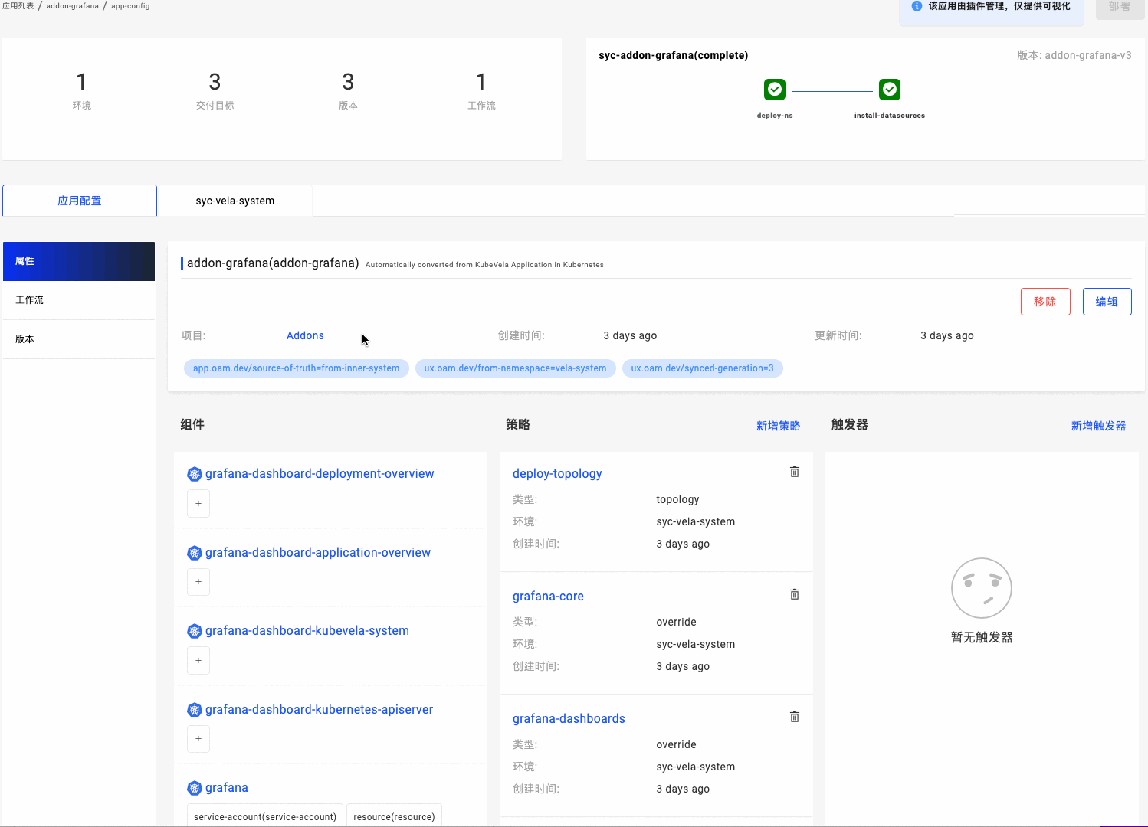
Observability as first class citizen
Observability works for all extended resources across multi-clusters.
vela status
vela top
vela debug
Resource Topology
History Logs
vela port-forward
vela exec
vela logs
Cloud Shell
Workflow Progress
Vela CLI
VelaUX
KubeVela Application
observability traits
Dashboard
Metrics
Logs
Grafana
Prometheus
Loki
Consistent experience for all extension.
Topology graph from application to underlying resources.

Slide 23
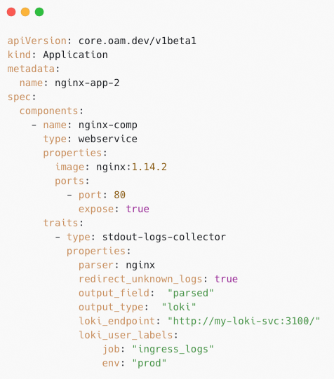
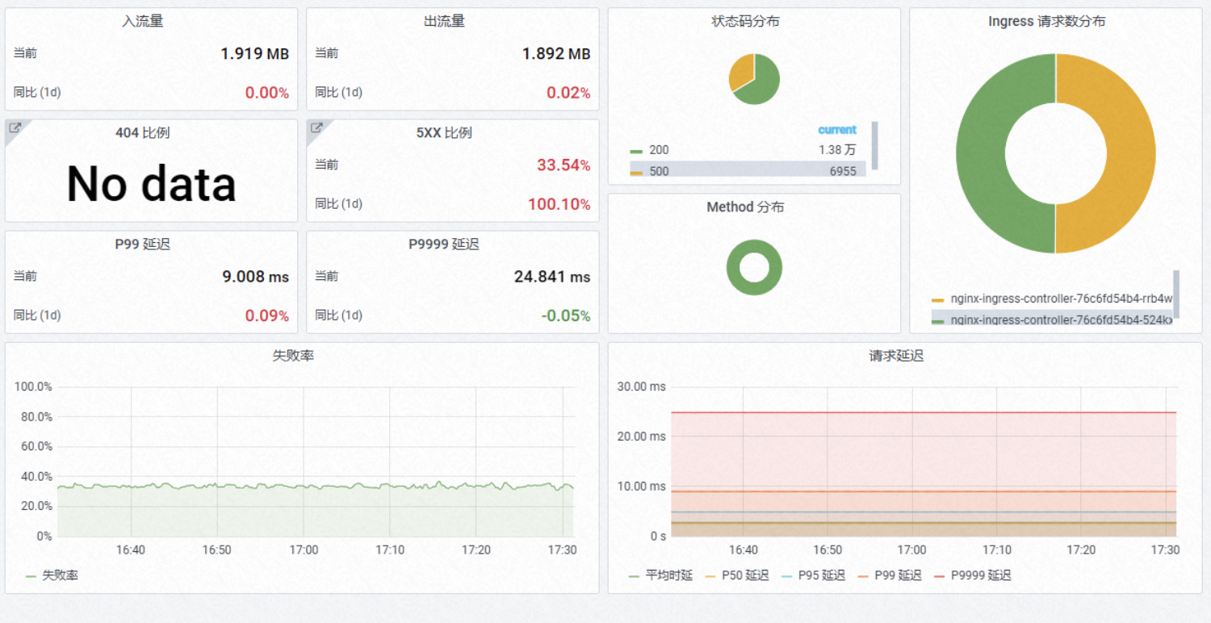
Observability as first class citizen
Observability for all extended resources.
vela status
vela top
vela debug
Resource Topology
History Logs
vela port-forward
vela exec
vela logs
Cloud Shell
Workflow Progress
Vela CLI
VelaUX
KubeVela Application
observability traits
Dashboard
Metrics
Logs
Grafana
Prometheus
Loki (vector)
Application Centric Observability.
Observability as Code.
With the use of customized Components and Traits, users can define how to monitor applications, for example, the way logs are collected and the dashboards metrics are plotted on.
The Observability rules for applications are managed in declarative ways. It makes updates and migrations more convenient and controllable. Developers can leverage the power of underlying monitoring infrastructures without the need of learning varying complex syntax.

Slide 24
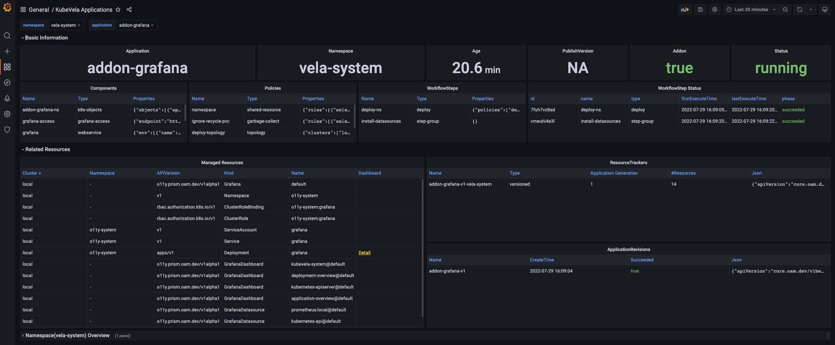
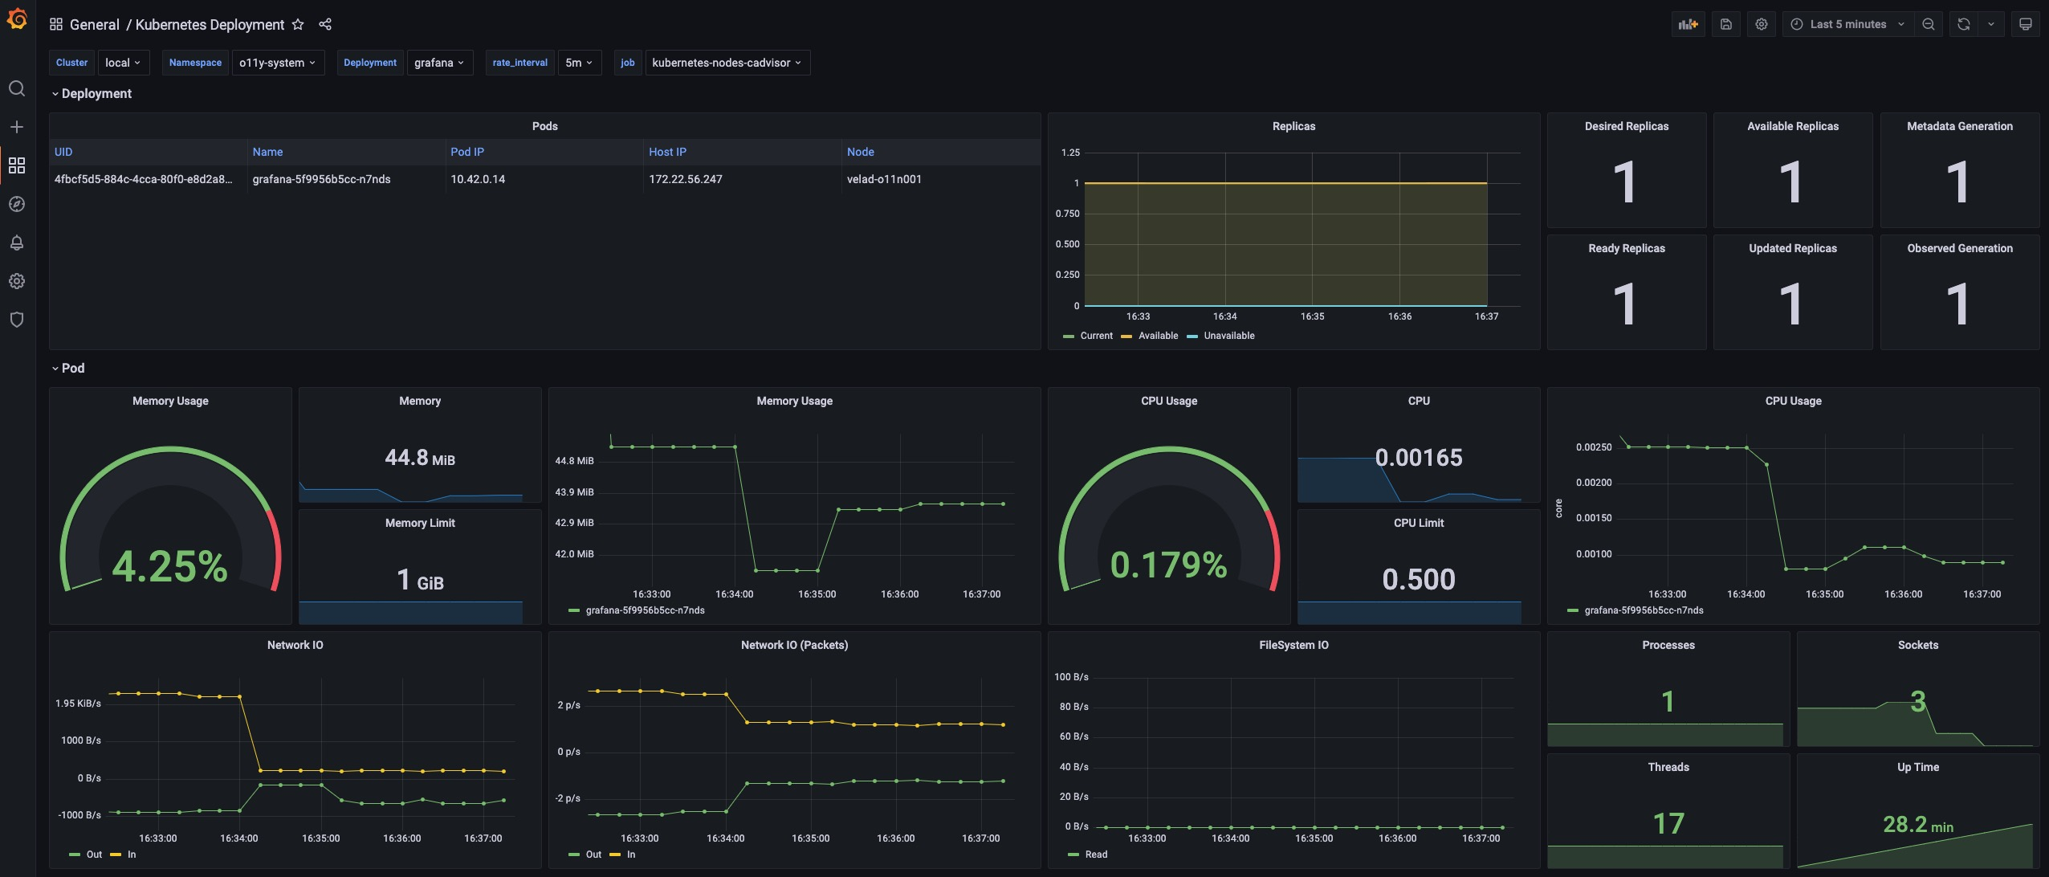


Observability as first class citizen
Automated System Observability
Application Dashboard.
Kubernetes native resources Dashboard.
KubeVela System Dashboard.
Kubernetes APIServer Dashboard.

Slide 25



KubeVela Eco-system: Tools
VelaUX is the Web UI for KubeVela. Besides, it incorporates business logics into fundamental APIs and provides out-of-box user experiences for non-k8s-expert users.
The extension API server for KubeVela built upon the Kubernetes Aggregated API Server. It projects native APIs like creating dashboards on Grafana into Kubernetes resource APIs, so that users can manage 3rd-party resources as Kubernetes native resources.
KubeVela CLI provides various commands that helps you to operate applications, such as managing definitions, viewing resources, restarting workflow, rolling versions.
Addons
API
(K8s CRD)
Vela CLI
VelaUX
(UI Console)
GitOps
Vela UX
Vela Prism
The workflow engine translates CUE-based steps and executes them. It works as a pure delivery tool and can be used aside by the KubeVela application. Compared to Tekton, it mainly organize the process in CUE style, instead of using Pods and Jobs directly.
Vela Workflow
Deployment as Code
Workflow
Across Clusters Delivery
Observability
Security
VelaD
KubeVela Control Plane
Building on top of k3s & k3d, VelaD integrates KubeVela with Kubernetes cores, which can be extremely helpful for building dev/test environment.
Terraform Controller
Cluster Gateway
More than
50+
Community
Addons…
Cloud Providers
Multi Kubernetes Clusters
IoT/Edge
The terraform controller in KubeVela allows users to use Terraform to manage cloud resources through Kubernetes Custom Resources.
The gateway that provides unified multi-cluster access interface. Working as Kubernetes Aggregated API Server, the gateway leverages the native Authentication and Authorization modules and enforces secure and transparent access to managed clusters.
Open Cluster
Management
…
https://github.com/kubevela/

Slide 26
Play with KubeVela

Slide 27
KubeVela Stability
Performance and Fine-tuning
Scale | #Nodes | #Apps | #Pods | #Threads | QPS | Burst | CPU | Memory
Small | < 200 | < 3,000 | < 18,000 | 2 | 300 | 500 | 0.5 | 1Gi
Medium | < 500 | < 5,000 | < 30,000 | 4 | 500 | 800 | 1 | 2Gi
Large | < 1,000 | < 12,000 | < 72,000 | 4 | 800 | 1,000 | 2 | 4Gi
NOTE: The above configurations are based on medium size applications (each application contains 2~3 components and 5~6 resources).
System Monitoring
Load Testing
Customized Tunning
The observability infrastructures also include the necessary tools for monitoring the health status of KubeVela control plane. Exceptions and performance bottlenecks will be exposed by the metrics and dashboards.
Several rounds of load testing of KubeVela system has demonstrated that KubeVela is capable of processing thousands of applications under limited resources. The capacity can be scaled up almost linearly given more resources.
As KubeVela can be used under various scenarios, it is possible to crop partial capabilities of KubeVela in return of higher performance.

Slide 28




KubeVela Adopters
Areas uses KubeVela.
Commercial
Banks
Car
Manufacturers
Cloud
Providers
Game
Companies
KubeVela is applied across various areas to help manage application systems, especially high-tech industries.
https://github.com/kubevela/community/blob/main/ADOPTERS.md
Notes:
可以加一个 adoptors 的链接

Slide 29
KubeVela Community
KubeVela attracts world-wide contributors and continuously evolves.
Contributors
KubeVela has attracted over 200 contributors from various countries, including China, USA, India, Germany, Korea, Spain, etc.
Issues
KubeVela received over 1,400 issues and has solved 85% of them.
Biweekly Community Meetings
KubeVela holds bi-weekly community meetings and has recorded 30+ English meetings on YouTube.
https://github.com/kubevela/community
Notes:
Community 链接，加上欢迎加入

Slide 30


Slide 31



What is OAM?
Open Application Model（OAM）
一个构建云原生应用管理平台的标准规范
2021.5 中国信通院发布以 OAM 为基础的行业标准
“云计算开放应用模型”
关注点分离：简化心智负担。
基础设施无关：一次定义，随处运行。
高度可扩展：充分复用云原生生态。
2019.10 月联合发布
http://www.ccsa.org.cn/standardDetail?standardNum=YD%2FT%204046-2022

Slide 33


KubeVela Application
observability traits
Dashboard
Metrics
Logs
Grafana
Prometheus
Loki (vector)

